Slide 1


DG INTERNS HUB
VAPT Project
Web Security & Vulnerability Assessment / Penetration Testing
Target: DVWA (Damn Vulnerable Web Application) | Tools: Burp Suite & OWASP ZAP
Avisha Masih
Cybersecurity Intern | SIN: DG/AUGUST/CYBER/098
30 September 2026

Slide 2
OVERVIEW
What This Project Covers
01
02
03
04
Understand VAPT
Set Up a Safe Lab
Exploit Manually
Scan Automatically
Study how Vulnerability Assessment & Penetration Testing identifies real web-app risk.
Deploy DVWA on Kali Linux as an isolated, legal target for testing.
Use Burp Suite to intercept and exploit SQL Injection and XSS by hand.
Run OWASP ZAP to catch configuration-level issues at scale.
VAPT Project — DG Interns Hub
2

Slide 3
TOOLKIT
Tools Used
1
DVWA
Deliberately vulnerable PHP/MySQL app used as the test target (Security Level: Low).
2
Burp Suite
Intercepting proxy used to capture, inspect, and modify live HTTP requests.
3
OWASP ZAP
Automated DAST scanner — spiders the app and flags common vulnerabilities.
4
Kali Linux
Security-focused Linux VM hosting the entire isolated test environment.
VAPT Project — DG Interns Hub
3

Slide 4
METHODOLOGY
How the Testing Was Done
1
Set up isolated Kali Linux VM + DVWA
2
Set Security Level to Low
3
Intercept traffic with Burp Suite
4
Inject payloads & observe results
5
Run OWASP ZAP automated scan
6
Record findings & assign risk levels
VAPT Project — DG Interns Hub
4

Slide 5
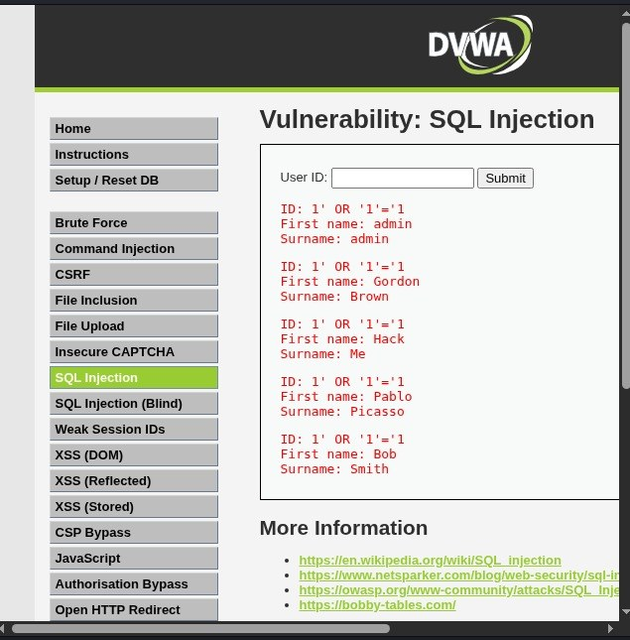
FINDING 01
SQL Injection
CRITICAL
Module: /vulnerabilities/sqli/
Payload
1' OR '1'='1
Always-true condition bypasses the WHERE clause entirely.
Impact
Full user table disclosed with no valid login
UNION-based technique extracted password hashes
No authentication required to trigger the flaw
All 5 users disclosed in one response
VAPT Project — DG Interns Hub
5

Slide 6
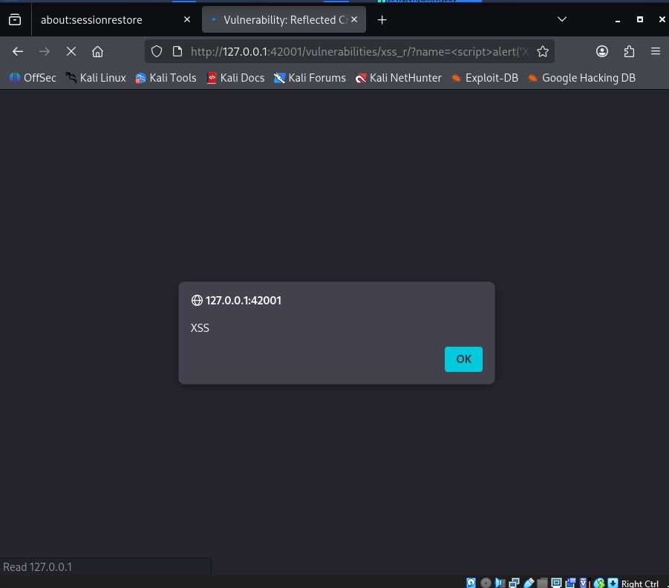
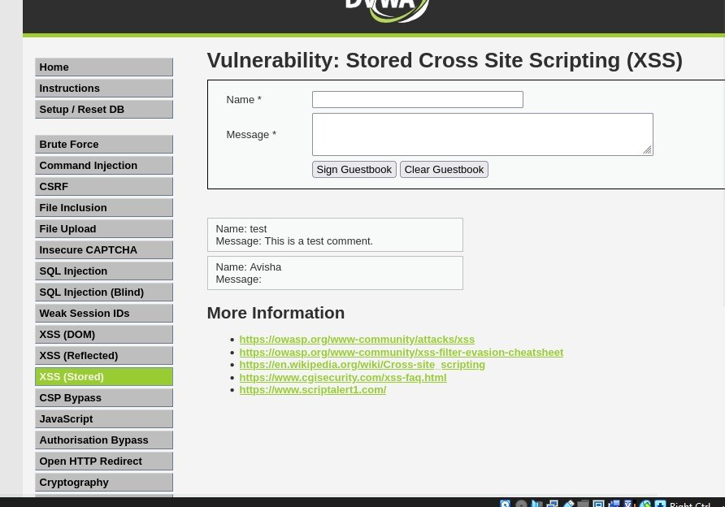
FINDING 02 & 03
Cross-Site Scripting (XSS)
HIGH
Reflected XSS
Stored XSS
<script>alert('XSS')</script>
<script>alert('Stored XSS')</script>
Script executes via a crafted link — no data is stored.
Payload is saved to the database — fires for every visitor.
VAPT Project — DG Interns Hub
6

Slide 7
AUTOMATED SCAN
OWASP ZAP — 9 Alerts Found
CSP Header Not Set
Medium
Anti-clickjacking Header Missing
Medium
Server Version Leak
Low
X-Content-Type-Options Missing
Low
Cookie without SameSite
Low
+ 4 more Low/Informational alerts — full detail in the project report
VAPT Project — DG Interns Hub
7

Slide 8
SUMMARY
Findings & Risk Levels
Vulnerability | Method | Risk
SQL Injection | Manual (Burp Suite) | Critical
XSS — Reflected | Manual (Burp Suite) | High
XSS — Stored | Manual (Burp Suite) | High
CSP Header Not Set | Automated (OWASP ZAP) | Medium
Missing Anti-clickjacking Header | Automated (OWASP ZAP) | Medium
Server Version / Cookie / Header Leaks | Automated (OWASP ZAP) | Low
VAPT Project — DG Interns Hub
8

Slide 9
RECOMMENDATIONS
Mitigation Methods
Injection Flaws
XSS
Misconfiguration
Use parameterised queries / ORM
Context-aware output encoding
Set X-Frame-Options / CSP headers
Validate & sanitise all input server-side
Strong Content-Security-Policy header
Add X-Content-Type-Options: nosniff
Apply least-privilege DB accounts
HttpOnly + Secure cookie flags
Patch software; hide version banners
VAPT Project — DG Interns Hub
9

Slide 10
DG INTERNS HUB
Conclusion
Manual testing catches what automated scanning misses — and automated scanning catches what manual testing overlooks. A mature VAPT process needs both, backed by secure coding practices at the source.
Thank You
Avisha Masih | Cybersecurity Intern, DG Interns Hub

